Slide 1
Login to Parental Portal.
If you do not have an account, please select Create Account before proceeding.
CLICK

Slide 2
Once logged in, select Apps | Services | Sites tab.
CLICK

Slide 3
CLICK
Next, select OSP (Online School Payments).

Slide 4
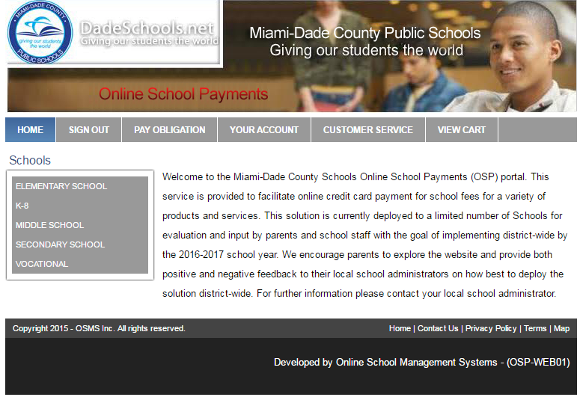
Select Secondary School.
CLICK

Slide 5
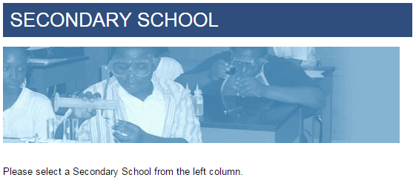
Scroll down until you find our school: TERRA Environmental Research Institute.
CLICK

Slide 6
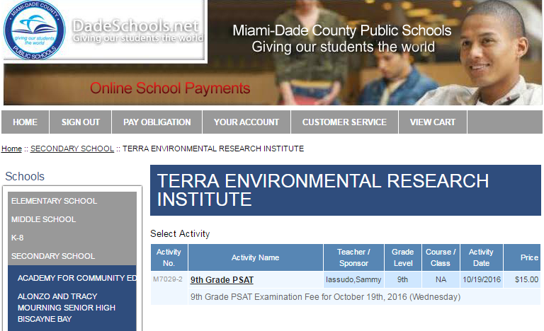
Select the fee or program you would like to pay for.
Please make sure you provide your child’s name and ID number. Do not put your name.
Note: In this example, PSAT is the only available option.

Slide 7
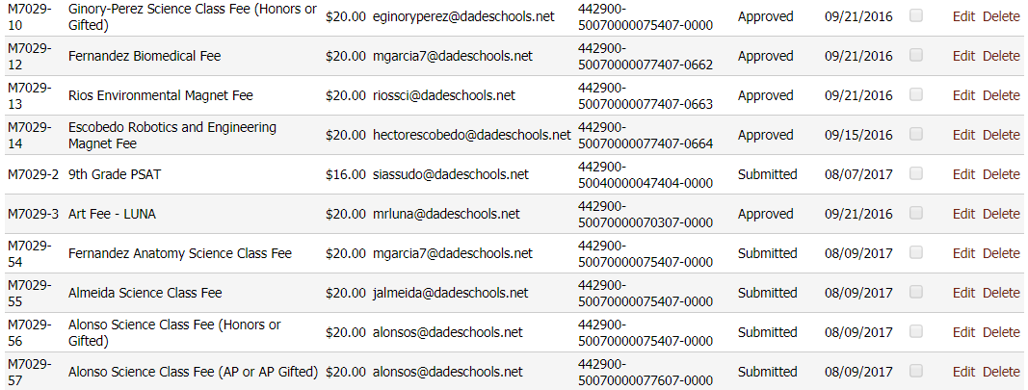
Please make sure you are selecting the correct TEACHER, department, and level.
For example, notice how Ms. Alonso teaches sections of Honors/Gifted and AP/AP Gifted. Please select your child’s class.

